Slide 1
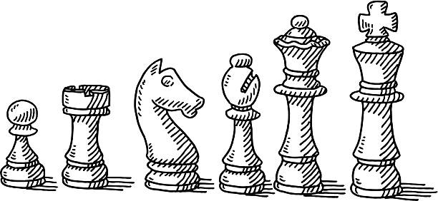
Blind Chess
Michael Cummins and Devin Franchino
CS 474

Slide 2
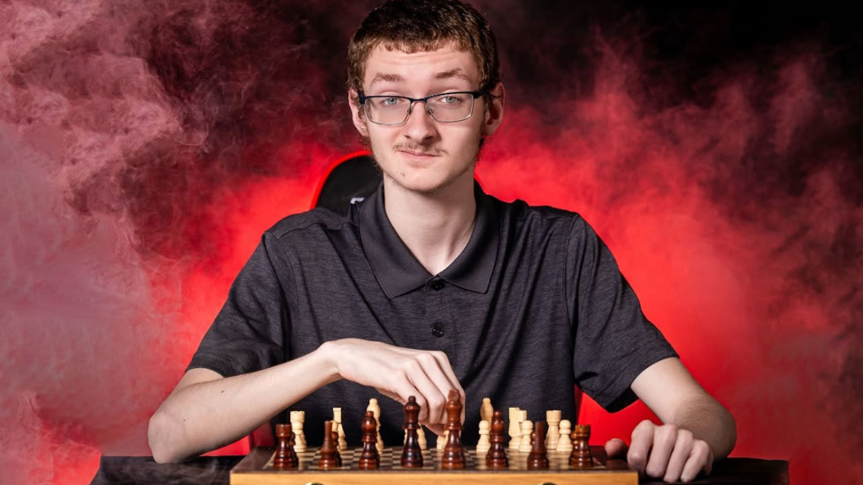
Overview of Project
Allow for the game of chess to played seamlessly with voice commands for people of all visual capabilities
Input / feedback through audio and visual channels
Users have capability to practice blind chess, revealing the board, asking about piece information, and being informed of incorrect moves

Slide 3
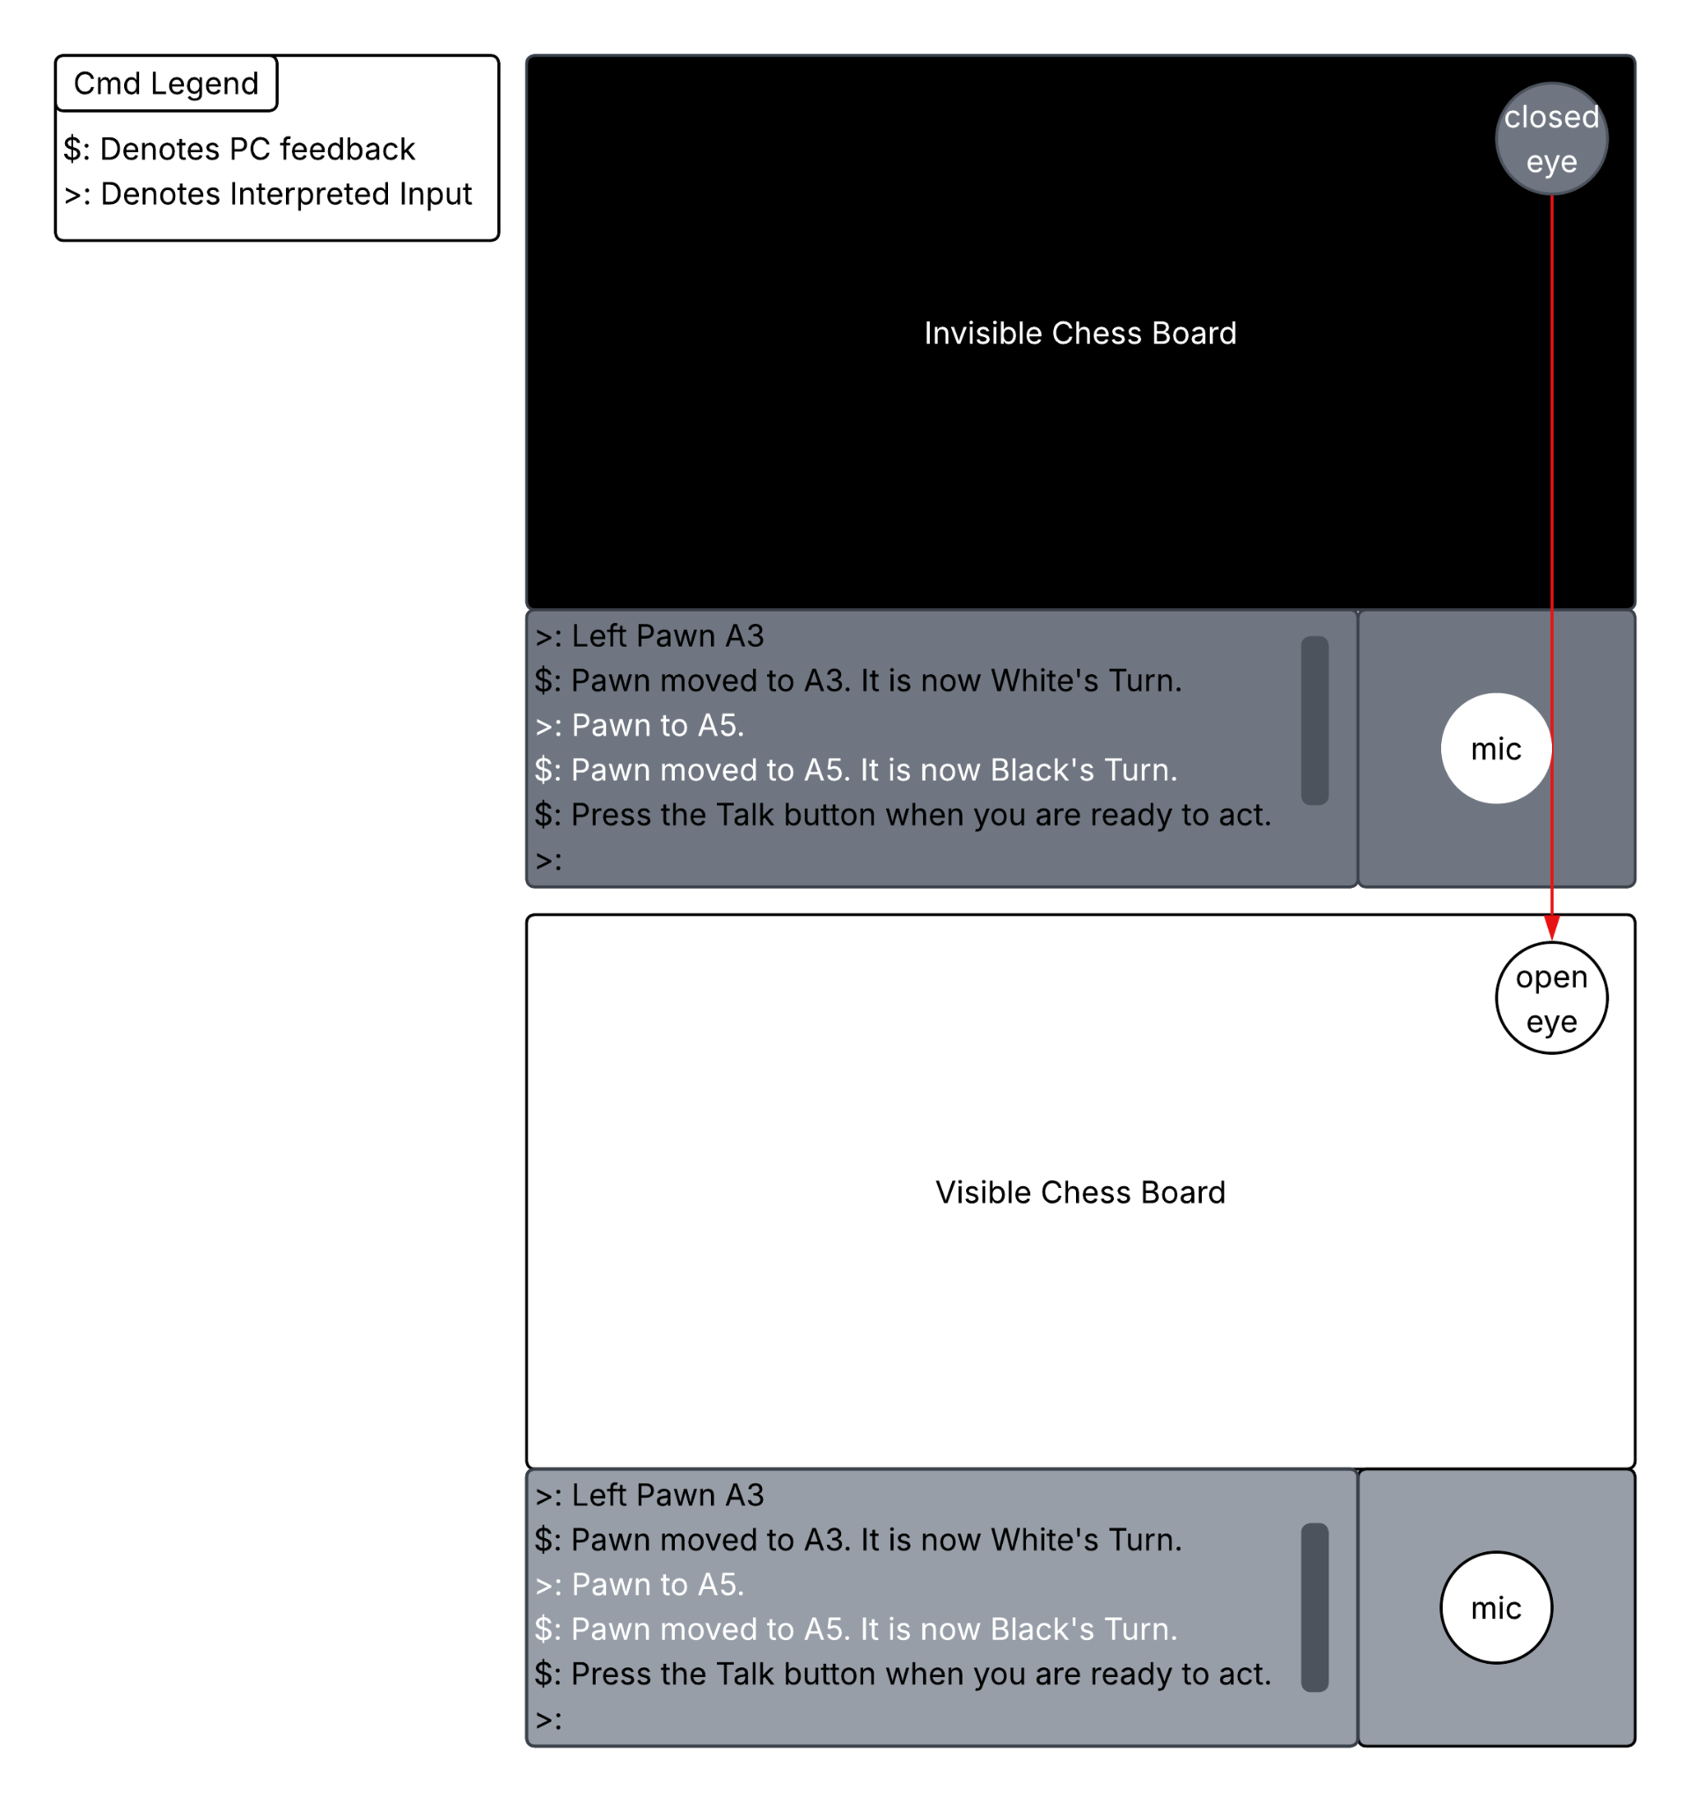
Original Design Plan
Backend chess logic would be plugged into a UI
UI has 4 main components:
Screen
Reveal, hide board
Eyeball Graphic
Chess Board
Game map
Updates as the game progresses in backend.
Console
Color Coded Textual feedback for the player.
>,$ characters denote User, PC input.
Text would also be narrated audibly
Scrollbar to see game history.
Button Panel
Houses PTT Button
Nice Button Graphic

Slide 4

Process (I)
Tools Used:
VSCode
Github
Lucid Chart
Modules Used:
Tkinter
RealtimeSTT
Pyttsx3
Threading
Dataclasses
etc…
Notes:
Michael Did the Logic, I did the UI / Controller

Slide 5
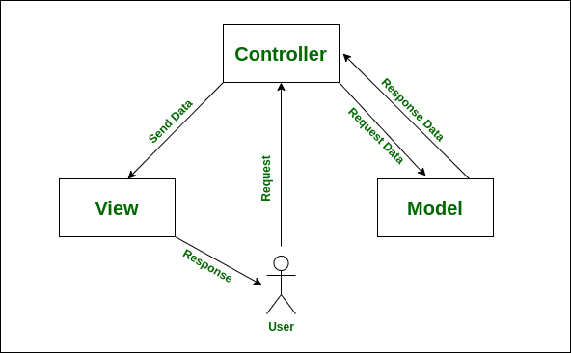
Process (II)
Model View Controller Approach
M: chesslogic.py
Describes the Rules of Chess
Movement
Win Conditions
Valid Commands
V:chessUI.py
Describes structure of the GUI
Buttons
Frames
C:game.py
Initiate logic and ui components
Bind buttons to controller functions
Map chess logic to UI counterparts

Slide 6

Struggles/Complications
Tkinter
Learning from scratch
Scroll Bar
PUSH TO TALK Button
Text-to-Speech (Lots of accidental Looping)
Chess Logic
Castling would delete the bishops/knights
En passant
Outlining all possible ways to textually (verbally) communicate chess moves

Slide 7

Final Product
Fully functioning blind chess game
All logic and interaction cases covered
Unimplemented Features:
UI Graphics
Eyeball
Button Sprites
Piece Sprites
Proper UI Scaling
Color-Coded Messages

Slide 8
Live Demo

